Slide 1
MONASH INFORMATION
TECHNOLOGY
Machine Learning: Clustering
Prajwol Sangat
Updated by Chee-Ming Ting (15 April 2022)

Slide 2
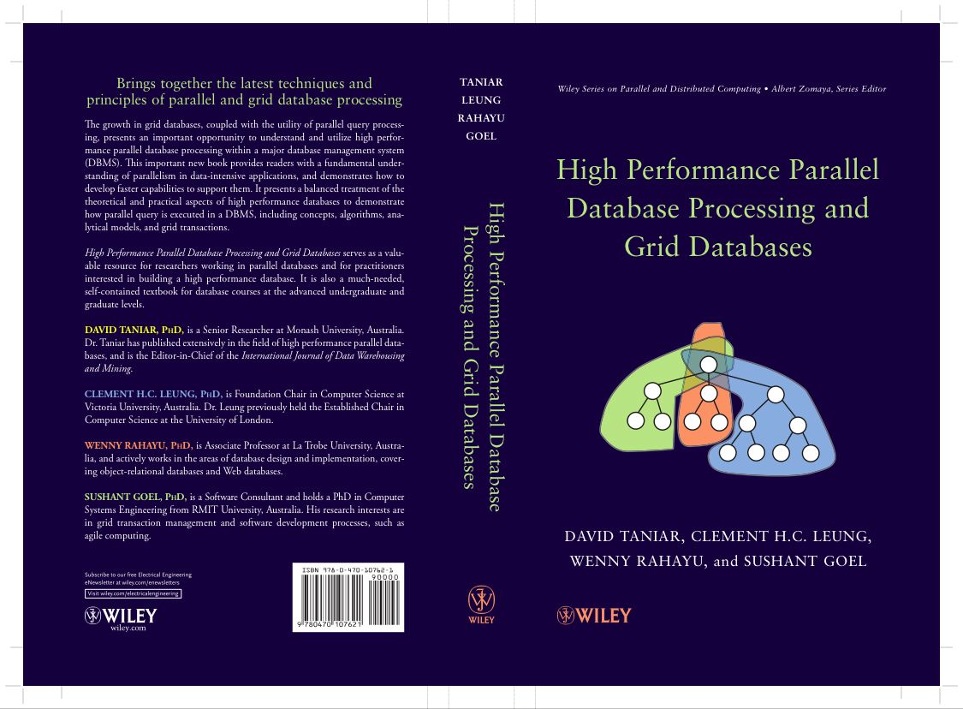
This week
Chapter 17 Parallel Clustering and Classification
17.1 Clustering and Classification
17.2 Parallel Clustering
17.3 Parallel Classification
17.4 Summary
17.5 Bibliographical Notes
17.6 Exercises

Slide 3
Machine Learning Fundamentals - Revision
Supervised learning vs. unsupervised learning
Supervised learning: discover patterns in the data that relate to data attributes with a target (class) attribute.
These patterns are then utilized to predict the values of the target attribute in future data instances.
Unsupervised learning: The data have no target attribute.
Exploring the data to find some intrinsic structures in them.

Slide 4
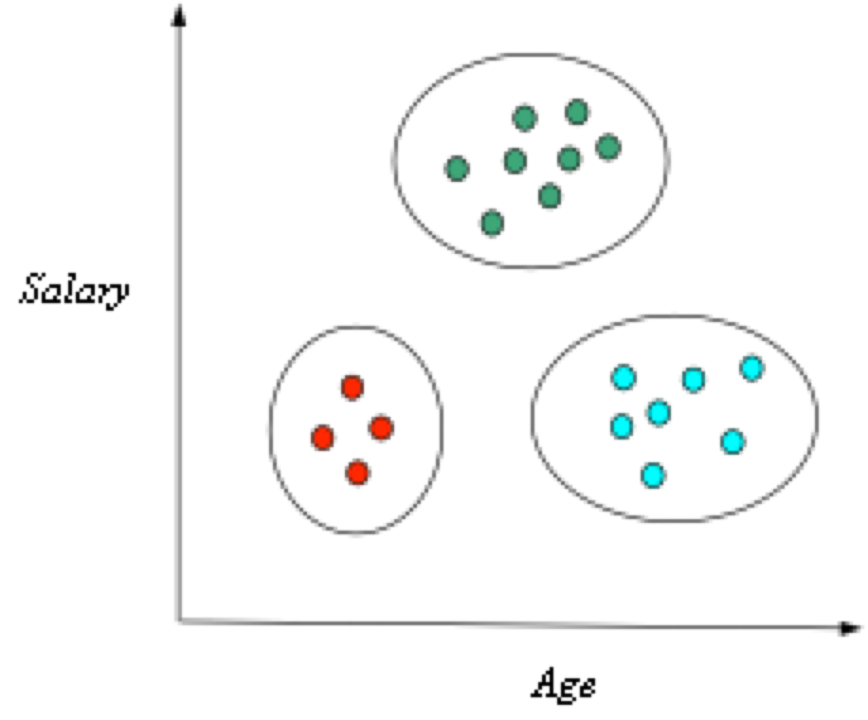
Clustering: an illustration
Finds groups (or clusters) of data
A cluster comprises a number of “similar” objects
A member is closer to another member within the same group than to a member of a different group (data points are similar within a cluster, less similar between clusters)
Groups have no category or label
Unsupervised learning
sub | salary | age
1
2
3
4
⁞
50
Definition:
Membership of a data point
- Indicates which cluster a point belong to

Slide 5
What is clustering for?
Let’s see some real-life examples
Example 1: Cluster students based on their examination marks, gender, heights, nationality, etc.
Example 2: In marketing, segment customers according to their similarities
To do targeted marketing.

Slide 6
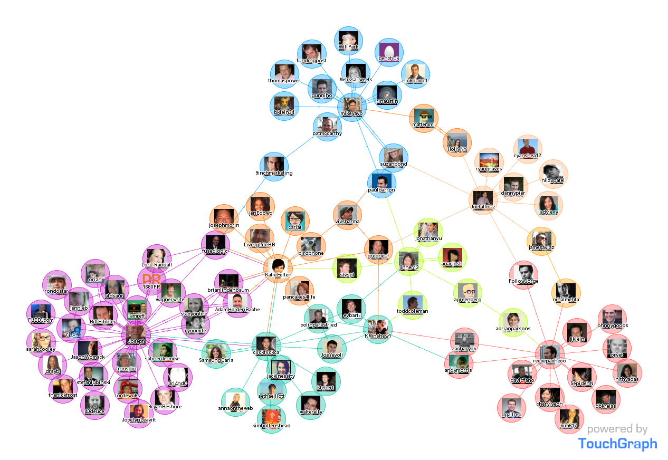
What is clustering for?
Clustering is one of the most utilized machine learning techniques.
Used in almost every field, e.g., medicine, psychology, botany, sociology, biology, archeology, marketing, insurance, libraries, etc.
Most popular applications of clustering are:
recommendation engines,
market segmentation,
social network analysis,
image segmentation,
anomaly detection
Image from: http://www.touchgraph.com/news

Slide 7
Some Applications in Digital Health
Partitioning of brain regions into clusters (communities)
Partitioning of Heart sound signals
Noman, Fuad, Sh-Hussain Salleh, Chee-Ming Ting. "A markov-switching model approach to heart sound segmentation and classification." IEEE Journal of Biomedical and Health Informatics 24, no. 3 (2019).
Ting, Chee-Ming, et al. "Detecting Dynamic Community Structure in Functional Brain Networks Across Individuals: A Multilayer Approach." IEEE Trans Medical Imaging (2020).

Slide 8
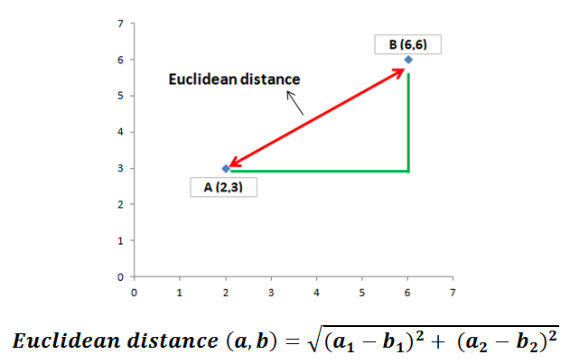
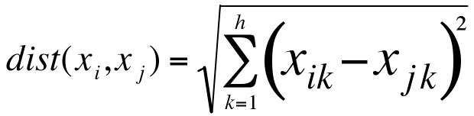
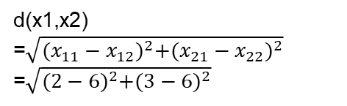
What is clustering for?
Similarities Measures
Key factor in clustering is the similarity measure
Measure the degree of similarity between two objects
Distance measure: the shorter the distance, the more similar are the two objects (zero distance means identical objects)
Euclidean Distance:
d(x1,x2) =$\sqrt{{(x_{11}−x_{12})}^{2}+{(x_{21}−x_{22})}^{2}}$
=$\sqrt{{(2−6)}^{2}+{(3−6)}^{2}}$
h = number of features (or attributes）

Slide 9
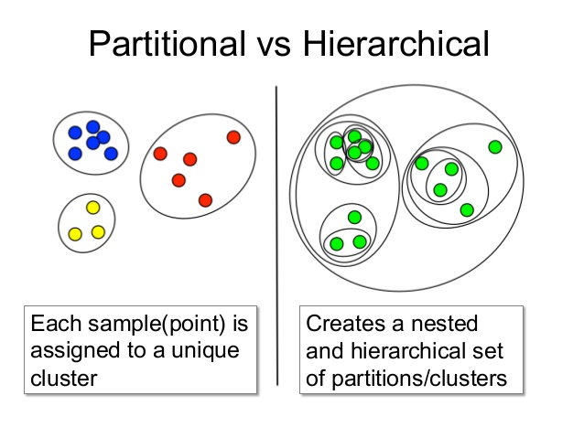
Clustering Techniques
Goal of clustering:
maximize intra-cluster similarity & minimize inter-cluster similarity
Hierarchical clustering (nested clustering)
Seeks to build a hierarchy of clusters (clusters within clusters)
Strategies:
Agglomerative: Bottom up approach
Divisive: Top down approach.
Partitional clustering (non-overlapping clustering)
Partitions the data objects based on a clustering criterion.
Places the data objects into clusters to maximise intra-cluster similarity.
So that data in a cluster are more similar to each other than to data in different clusters

Slide 10
K-Means clustering (Partitional clustering)
K-means is a partitional clustering algorithm
Let a set of data points (or instances) D be
{x₁, x₂, …, x_{n}},
where x_{i} = (x_{i1}, x_{i2}, …, x_{ir}) is a vector in a real-valued space X ⊆ R^{r}, and r is the number of attributes (dimensions) in the data.
The k-means algorithm partitions the given data into k clusters.
Each cluster has a cluster center, called centroid.
Centroid can be mean/average of member data points in each cluster
k is specified by the user
sub | salary | age
x1
x2
x3
x4
⁞
x50

Slide 11
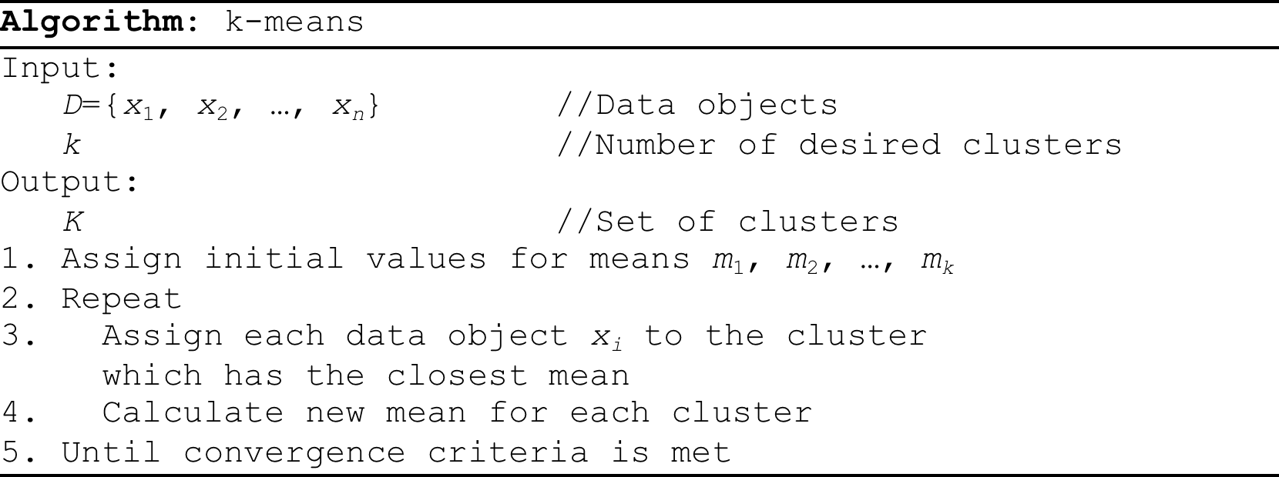
K-Means clustering
Algorithm k-Means:
(Initialization) Specifies k number of clusters, and guesses the k seed cluster centroid
(Assignment Step) Assign each data point to the cluster with the closest centroid
Current clusters may receive or loose their members
(Update Step) Each cluster must re-calculate the mean (centroid) based on the newly assigned members
The process is repeated until the clusters are stable (no change of members)

Slide 12
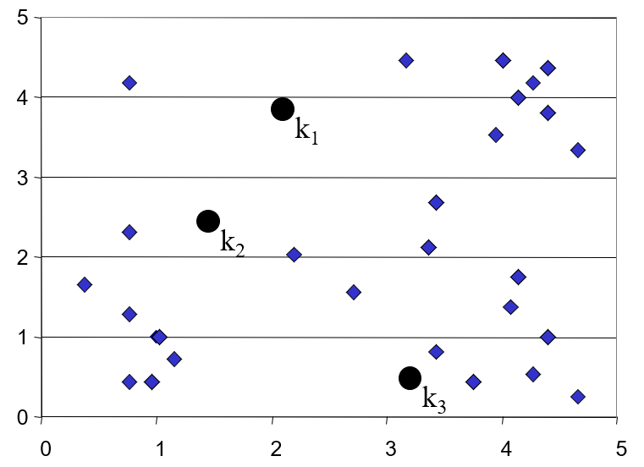
K-Means Clustering: Step 1
Algorithm: k-means, Distance Metric: Euclidean Distance
- (Initialization) Specifies k number of clusters, and guesses the k seed cluster centroid

Slide 13
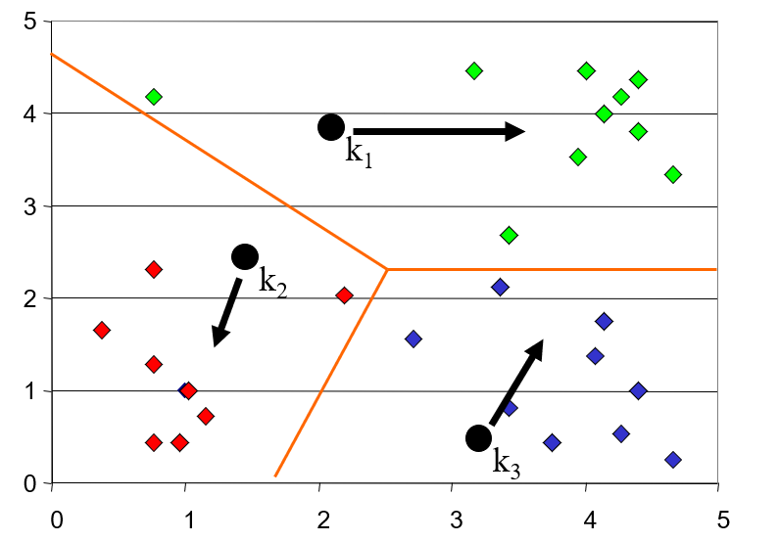
K-Means Clustering: Step 2
Algorithm: k-means, Distance Metric: Euclidean Distance
(Assignment Step) Iteratively looks at each data point and assigns it to the closest centroid

Slide 14
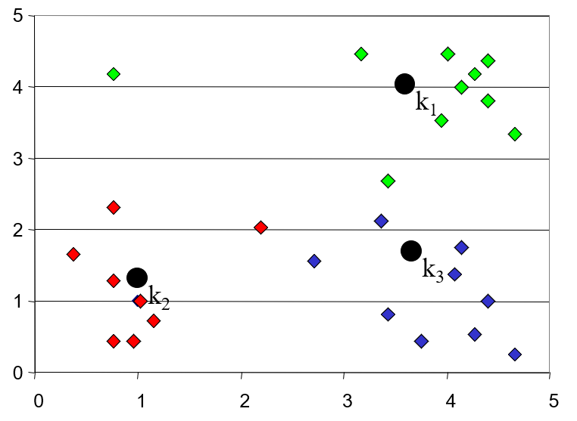
K-Means Clustering: Step 3
Algorithm: k-means, Distance Metric: Euclidean Distance
(Update Step) Re-calculate the mean (centroid) for each cluster based on the membership of the cluster

Slide 15
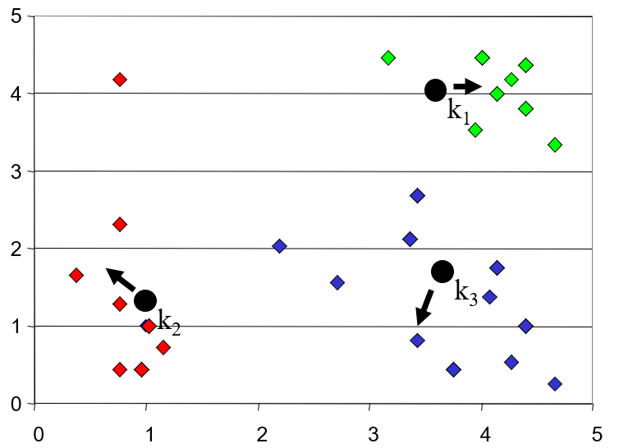
K-Means Clustering: Step 4
Algorithm: k-means, Distance Metric: Euclidean Distance
Iteratively looks at each data point and assigns it to the closest centroid,
Current clusters may receive or loose their members

Slide 16
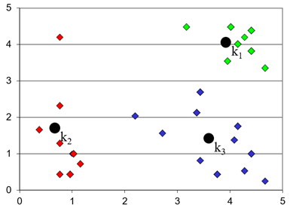
K-Means Clustering: Step 5
Algorithm: k-means, Distance Metric: Euclidean Distance
Re-calculate the mean (centroid) for each cluster based on the membership of the cluster

Slide 17
k-Means: Step-By-Step Example
Data D = {5, 19, 25, 21, 4, 1, 17, 23, 8, 7, 6, 10, 2, 20, 14, 11, 27, 9, 3, 16}
Number of clusters: k = 3
Initial centroids: m₁=6, m₂=7, and m₃=8
First Iteration
(Assignment Step) Clusters:
C₁={1, 2, 3, 4, 5, 6}
C₂={7}
C₃={8, 9, 10, 11, 14, 16, 17, 19, 20, 21, 23, 25, 27}
(Update Step) Re-calculated centroids: m₁=3.5, m₂=7, and m₃=16.9

Slide 18
k-Means: Step-By-Step Example
Clusters:
C₁={1, 2, 3, 4, 5, 6}
C₂={7}
C₃={8, 9, 10, 11, 14, 16, 17, 19, 20, 21, 23, 25, 27}
New centroids: m₁=3.5, m₂=7, and m₃=16.9
Second Iteration
Clusters:
C₁={1, 2, 3, 4, 5}
C₂={6, 7, 8, 9, 10, 11}
C₃={14, 16, 17, 19, 20, 21, 23, 25, 27}
Re-calculated centroids: m₁=3, m₂=8.5, and m₃=20.2

Slide 19
k-Means: Step-By-Step Example
Clusters:
C₁={1, 2, 3, 4, 5}
C₂={6, 7, 8, 9, 10, 11}
C₃={14, 16, 17, 19, 20, 21, 23, 25, 27}
New centroids: m₁=3, m₂=8.5, and m₃=20.2
Third Iteration
Clusters:
C₁={1, 2, 3, 4, 5}
C₂={6, 7, 8, 9, 10, 11, 14}
C₃={16, 17, 19, 20, 21, 23, 25, 27}
Re-calculated centroids: m₁=3, m₂=9.29, and m₃=21

Slide 20
k-Means: Step-By-Step Example
Clusters:
C₁={1, 2, 3, 4, 5}
C₂={6, 7, 8, 9, 10, 11, 14}
C₃={16, 17, 19, 20, 21, 23, 25, 27}
New centroids: m₁=3, m₂=9.29, and m₃=21
Fourth Iteration
Clusters:
C₁={1, 2, 3, 4, 5, 6}
C₂={7, 8, 9, 10, 11, 14}
C₃={16, 17, 19, 20, 21, 23, 25, 27}
Re-calculated centroids: m₁=3.5, m₂=9.83, and m₃=21

Slide 21
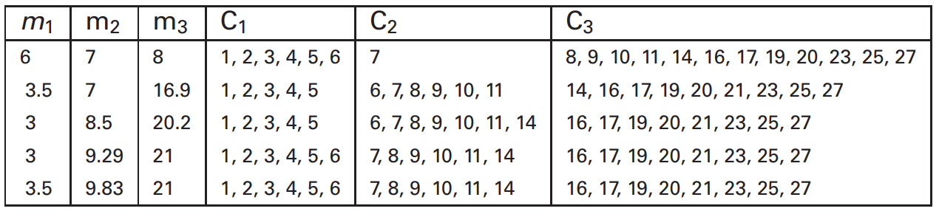
k-Means: Step-By-Step Example
Clusters:
C₁={1, 2, 3, 4, 5, 6}
C₂={7, 8, 9, 10, 11, 14}
C₃={16, 17, 19, 20, 21, 23, 25, 27}
New centroids: m₁=3.5, m₂=9.83, and m₃=21
Fifth Iteration
No data movement from clusters (Process Terminated)

Slide 22
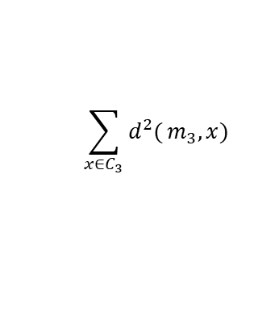
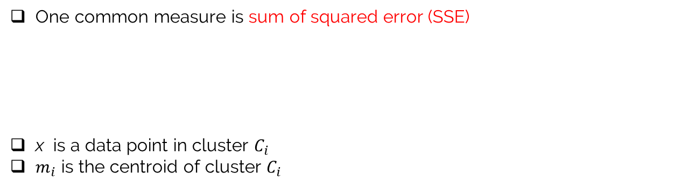
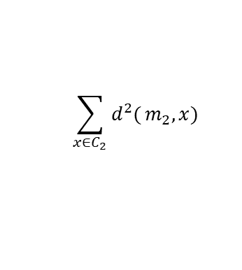
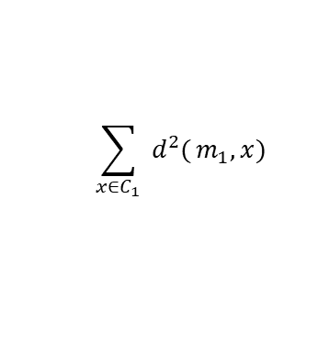
Evaluating K-Means Clusters
One common measure is sum of squared error (SSE)
x is a data point in cluster $C_{i}$
$m_{i}$ is the centroid of cluster $C_{i}$
SSE measures how close the assigned data points to centroids
small value → maximized intra-cluster similarity
$$\sum_{x∈C_{1}}{ d^{2}(}m_{1},x)$$
Example: How to calculate SSE?
$$\sum_{x∈C_{2}}{d^{2}(}m_{2},x)$$
Clusters:
C₁={1, 2, 3, 4, 5, 6}
C₂={7, 8, 9, 10, 11, 14}
C₃={16, 17, 19, 20, 21, 23, 25, 27}
centroids: m₁=3.5, m₂=9.83, and m₃=21
$$\sum_{x∈C_{3}}{d^{2}(}m_{3},x)$$

Slide 23
K-Means Clustering
The number of clusters k is predefined. The algorithm does not discover the ideal number of clusters. During the process, the number of clusters remains fixed – it does not shrink nor expand.
The final composition of clusters is very sensitive to the choice of initial centroid values. Different initialisations may result in different final clusters composition.

Slide 24
K-Means Clustering: Pros and Cons
Pros
Simple and fast for low dimensional data (time complexity of K Means is linear i.e. O(n))
Scales to large data sets
Easily adapts to new data points
• Cons
• It will not identify outliers
Restricted to data which has the notion of a centre (centroid)

Slide 25
K-means clustering
Exercise 1
Data D = {8, 11, 12, 14, 16, 17, 24, 28}
Number of clusters: k = 3
Initial centroids: m₁=11, m₂=12, and m₃=28
Use the k-means serial algorithm to cluster the data in three clusters

Slide 26
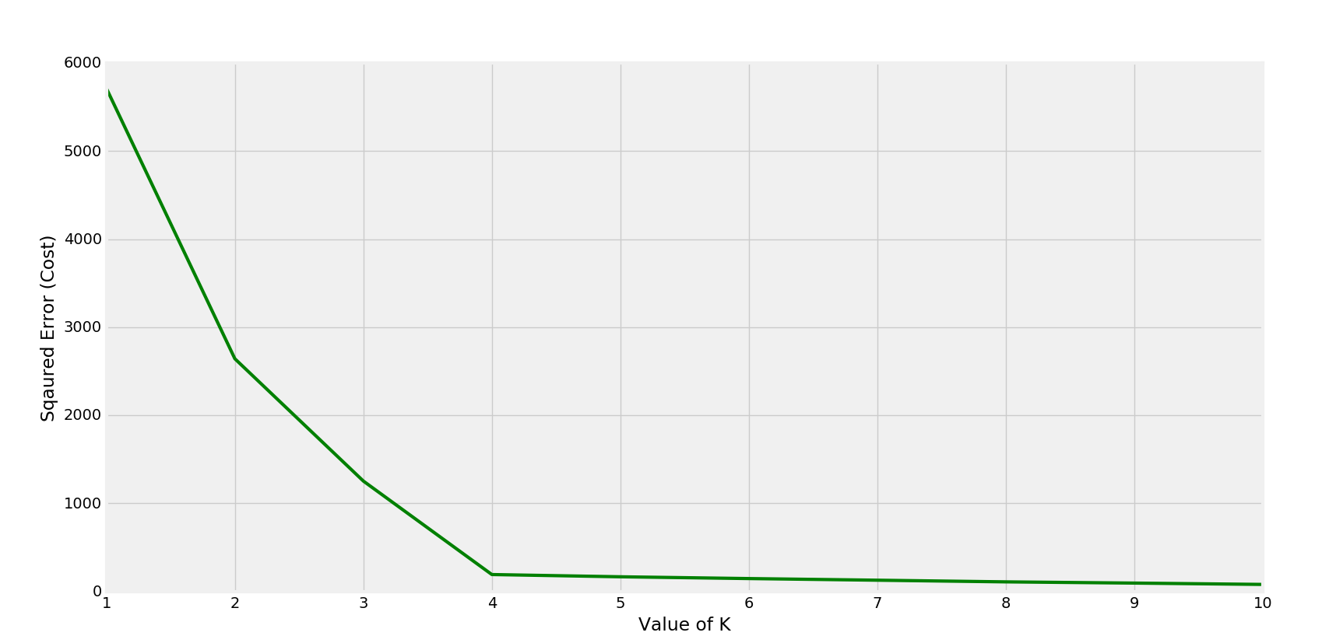
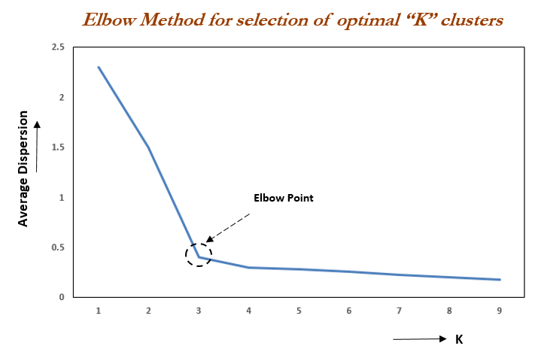

Finding Optimal number of the clusters
As k increases, clusters become smaller.
The neighbouring clusters become less distinct from one another.
.
How to choose an optimal k?
Elbow Method
Plot sum of squared errors as a function of k (a scree plot)
Select the value of k at the “elbow” ie the point after which the SSE start decreasing in a linear fashion.
Silhouette analysis
Measure of how close each point in one cluster is compared to points in the neighbouring clusters and provides a way to assess number of clusters.
If most points have a high silhouette value, then the clustering configuration is appropriate.
If many points have a low or negative value, then the clustering configuration may have too many or too few clusters.
optimal value for k = 4

Slide 27

DEMO
https://instaview365.com/request-a-demo/

Slide 28
This week
Chapter 17 Parallel Clustering and Classification
17.1 Clustering and Classification
17.2 Parallel Clustering
17.3 Parallel Classification
17.4 Summary
17.5 Bibliographical Notes
17.6 Exercises

Slide 29
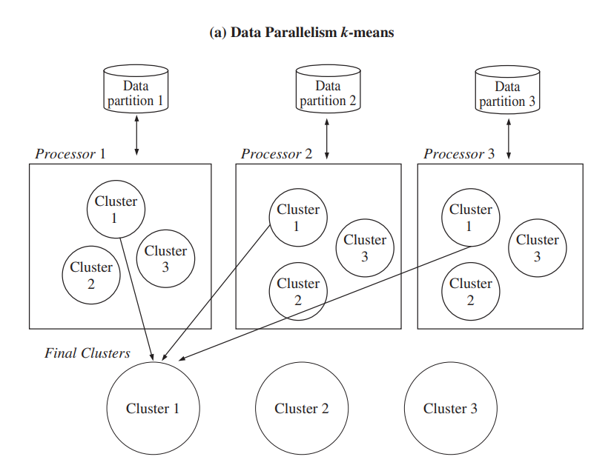
Parallel K-means clustering
Data parallelism of k-means
Create parallelism from the beginning because of partitioning of the dataset.
Data is partitioned into multiple partition
Each processor will work independently to create three clusters
The final clusters from each processor are respectively united

Slide 30
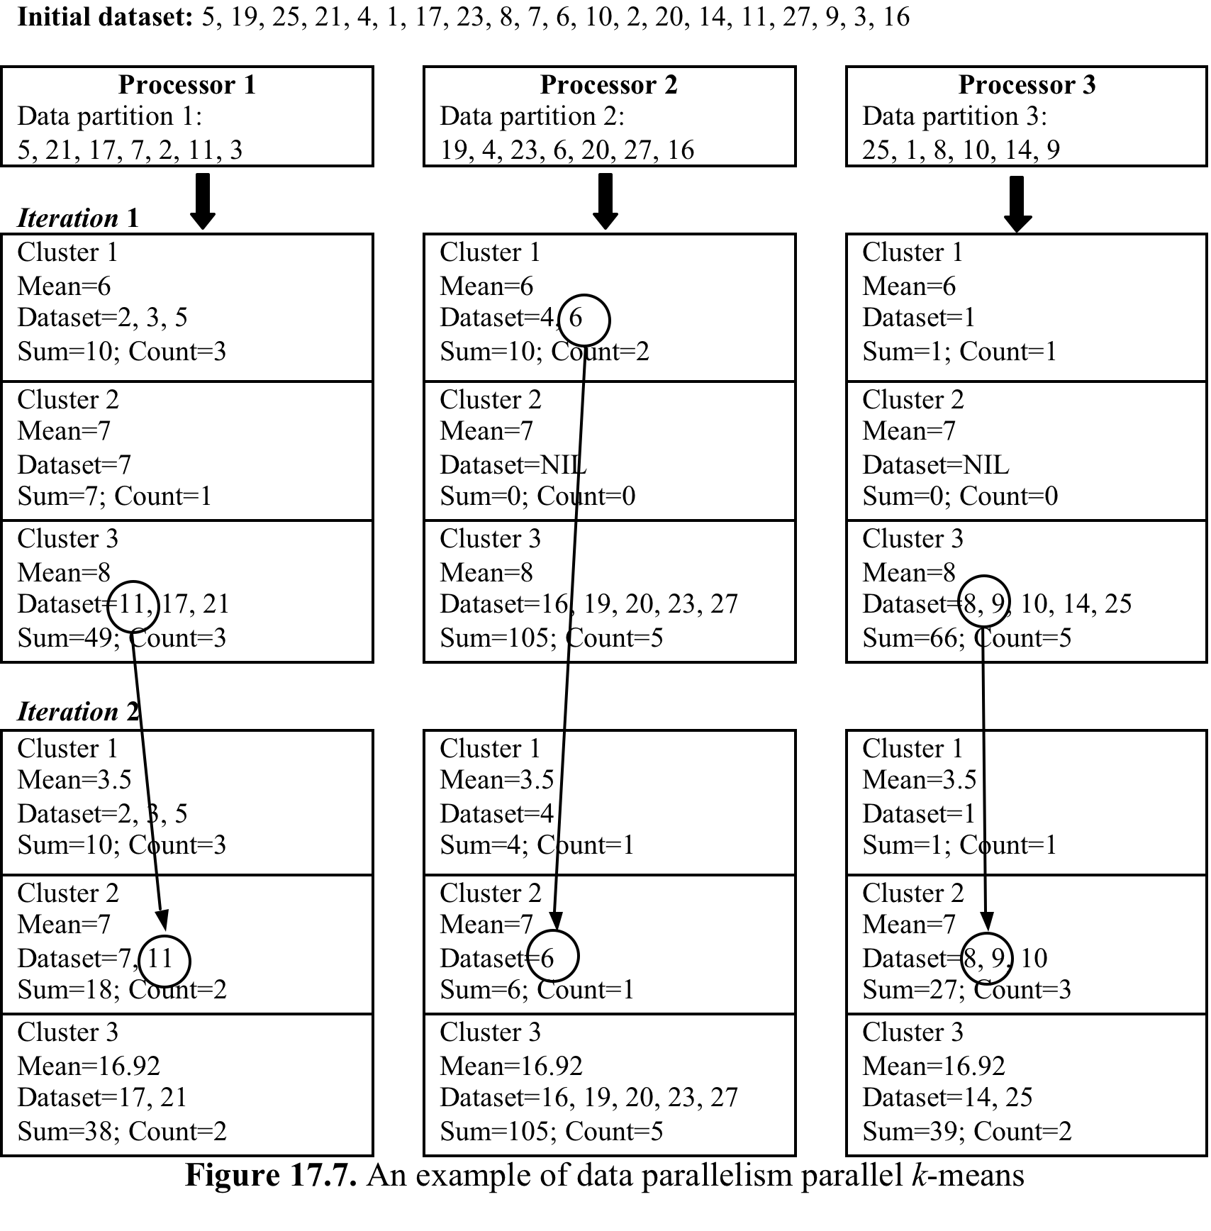
Parallel K-means
Data parallelism
Example: Data partitioning using round-robin
Initial centroids: 6, 7, 8
Each processor will run k_Means locally
At the end of each iteration, info about sum & count of data points in each local cluster is shared to calculate new centroid/mean
Data does not move among processors (it stays where it was allocated initially)
Data move across clusters within same processor

Slide 31
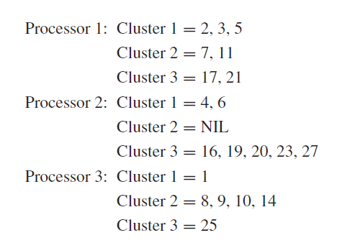
Parallel K-means
Data parallelism
k-means
Cluster 1 = 1, 2, 3, 4, 5, 6
Cluster 2 = 7, 8, 9, 10, 11, 14
Cluster 3 = 16, 17, 19, 20, 21, 23, 25, 27

Slide 32
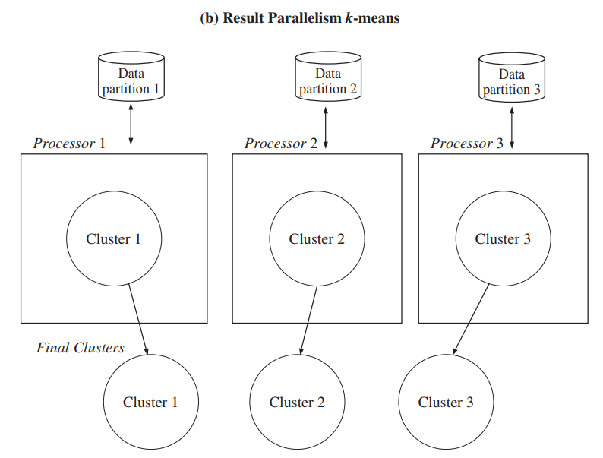
Parallel K-means clustering
Result Parallelism of k-means
Focuses on clusters partitioning
Each processor will work on a particular target cluster
For example, from the very beginning, processor 1 will produce only one cluster assigned to it, that is cluster 1.
During the iteration, the memberships of cluster can change. -→ data movement across processors

Slide 33
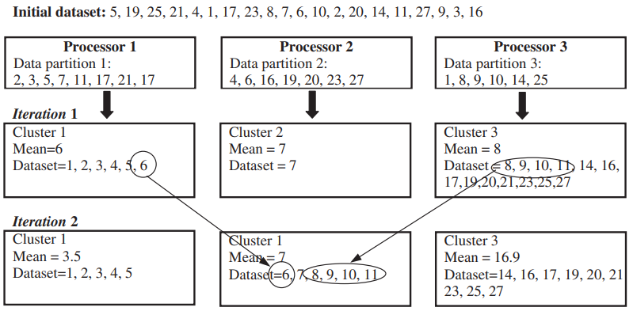
Parallel K-means
Result parallelism k-means
Example: Data partitioning using round-robin
Each processor is allocated only one cluster.
Three initial means are distributed among the three processors,
Data points may move from one processor to another at each iteration to join a cluster in a different processor
Since a cluster is processed by one processor, calculating the mean is straightforward because all the data points within a cluster are located at the same processor

Slide 34
Parallel K-means
Result parallelism k-means
At the end, the final cluster result is basically the union of all local clusters from each processor.
Processor 1 cluster 1 = 1, 2, 3, 4, 5, 6
Processor 2 cluster 2 = 7, 8, 9, 10, 11, 14
Processor 3 cluster 3 = 16, 17, 19, 20, 21, 23, 25, 27

Slide 35
Data parallelism vs Result parallelism
Data parallelism
Parallelism is created due to the fragmentation of initial input data
Each processor focuses on its partition of the dataset
Final results are formed by combining all local results produced by individual processors.
Result parallelism
Focuses on the fragmentation of the results, not necessarily the input data.
Each processor focuses on its target result partition.

Slide 36
What have we learnt today?
Partitional (k-means) to attain meaningful groups of data
Algorithmic examples for clustering of data

